Slide 1
Principal Component Analysis

Slide 2
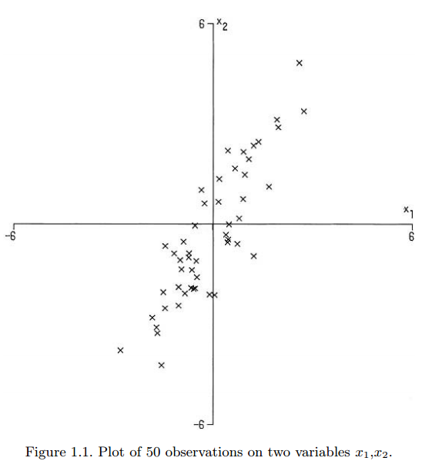
An intuitive example
B
What is the best line that represent this cluster of data?
Why?
C
A
D

Slide 3
Another question !
B
Choose one axis of each coordinate that best represents the dataset
Compare these two axis
Which one is better at representing the dataset?
C
A
D

Slide 4
INDEX
Principal Component Analysis?
Application
Calculation
Example

Slide 5
1. Principal Component Analysis?
A linear transformation
Transform the original coordinate into another new coordinate system
Largest variation of data lie in the first coordinate (1st principal component)
Number of axis (N) is the number of Principal Components
In multivariate analysis, each axis represents a feature (3-D = 3-PCAs; 4-D = 4-PCAs; …)

Slide 6
1. Principal Component Analysis?
First axis has the greatest variation of the dataset
Second axis (orthogonal) is the next axis contributing to the second highest variation
And so on…
Up to you to decide how many axis should be kept
BUT how many is small enough to not miss important characteristics of a dataset?

Slide 7
2. Application
Mainly used for dimensionality reduction while retaining the characteristics that contribute to the greatest variance of the dataset
Remove redundant, unclear variables
Visual Inspection of classifiers
Kind of unsupervised learning of machine learning
Study the hidden characteristics of the dataset

Slide 8

Eigenvalue and Eigenvector
Eigenvector (characteristic vector) of a linear transformation is a non-zero vector that does not change direction when the linear transformation is applied to it
Eigenvalue is the scaling of the eigenvector after transformation
Eigenvectors are either parallel or orthogonal with the direction of the transformation A

Slide 9
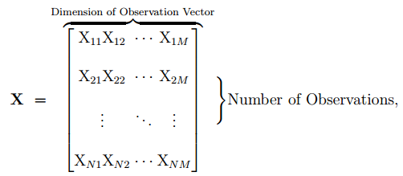

3. Calculation
Organizing the dataset: Suppose a training dataset X has N samples, each sample has M features
Calculate the empirical mean row vector: the mean of each features

Slide 10


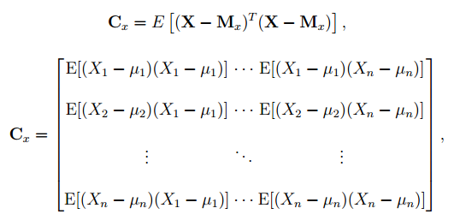
3. Calculation
Calculate deviation from the mean: each row is subtracted with the empirical mean row
Find the covariance matrix of the new vector

Slide 11
3. Calculation
Calculate eigenvector and eigenvalue of the covariance matrix: usually use computing algorithm to do the calibration
Rearrange the eigenvalues: the eigenvector of the highest eigenvalue is the first PCA, second highest is the second PCA and so on …
How MANY PCA we should keep?
THEN compute the cumulative energy:

Slide 12
3. Calculation
Select a number of PCAs until it reaches a minimum value of cumulative energy (usually 90%)
Calculate scores: perform linear projection of the original dataset into the new coordinate system

Slide 13
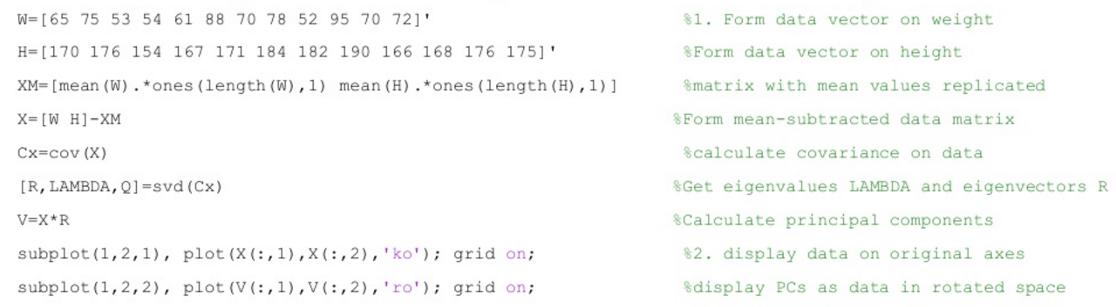
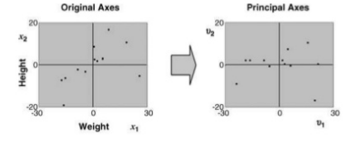
3. Calculation: Matlab Implementation

Slide 14
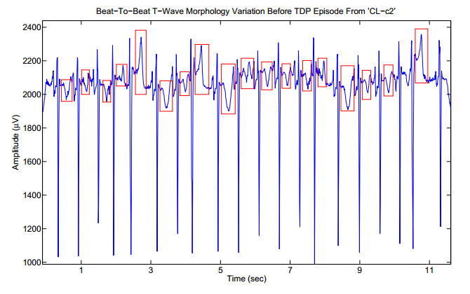
4. Example
Using PCA to study the T wave morphology of Torsad De Points (TDP)

Slide 15
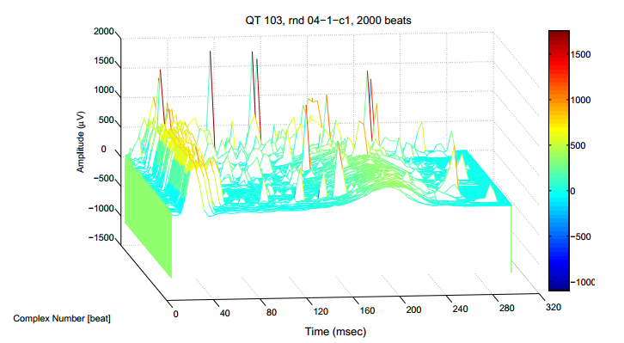
4. Example
Extraction of QRST complex
Produce an NxM dataset with N is the number of QRST complex and M is the number of point within each QRST complex
Resampling the number of point of each QRST complex into the same value

Slide 16
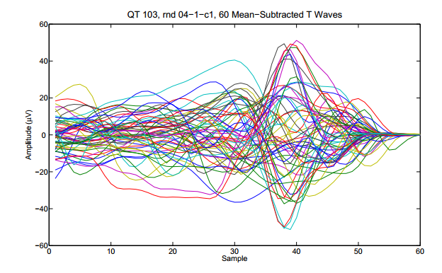
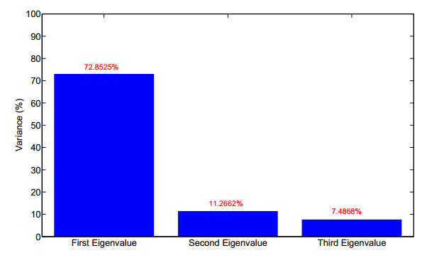
4. Example

Slide 17
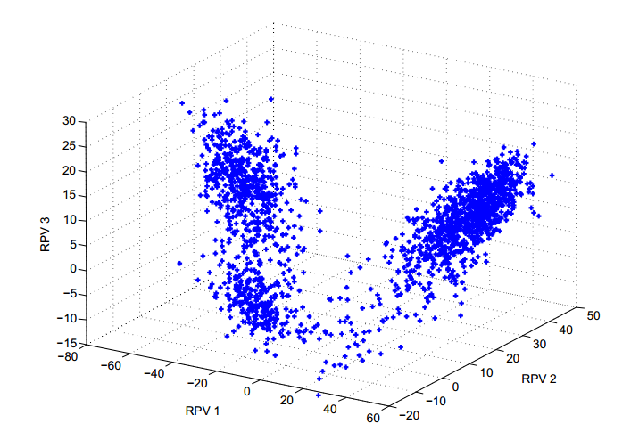
4. Example

Slide 18
Conclusion and Discussion
PCA is a method used to reduce the dimension of a dataset while retaining highest variation possible
Wide applications: remove unwanted parameters, avoid redundancy, visual inspection of classifiers, unsupervised learning for machine leaning, …
CHALLENGES
Assume a linear relationship between variables
Computationally expensive to calculate

Slide 19
THANK YOU

